Slide 1
Working with XML and JSON Serializing

Slide 2
Objectives
Overview Serialization in .NET
Understanding Serialization Engines in .NET
Explain about how serialization works
Describe use Serialization
Overview XML Serialization
Overview JSON (JavaScript Object Notation) Serialization
Create demo using XML with WPF application
Create demo XML Serialization in .NET application
Create demo JSON Serialization in .NET application

Slide 3
Overview .NET Serialization

Slide 4
Understanding Serialization in .NET
Serialization is the act of taking an in-memory object or object graph (set of objects that reference one another) and flattening it into a stream of bytes, XML, JSON, or a similar representation that can be stored or transmitted
Deserialization works in reverse, taking a data stream and reconstituting it into an in-memory object or object graph
There are four serialization engines in .NET :
XmlSerializer (XML)
JsonSerializer (JSON)
The data contract serializer (XML and JSON)
The binary serializer (binary)

Slide 5
Understanding Serialization Engines
XmlSerializer: Serializes and deserializes objects into and from XML documents. The XmlSerializer enables us to control how objects are encoded into XML
JsonSerializer: Provides functionality to serialize objects or value types to JSON and to deserialize JSON into objects or value types
The Data Contract Serializer: Serializes and deserializes an instance of a type into an XML stream or document using a supplied Data Contract (classes)

Slide 6
Understanding Serialization Engines
The Binary Serializer: Serialization can be defined as the process of storing the state of an object to a storage medium. During this process, the public and private fields of the object and the name of the class, including the assembly containing the class, are converted to a stream of bytes, which is then written to a data stream. When the object is subsequently deserialized, an exact clone of the original object is created

Slide 7
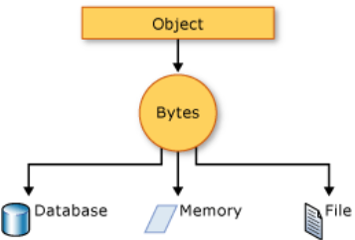
How Serialization Works
The object is serialized to a stream that carries the data. The stream may also have information about the object's type, such as its version, culture, and assembly name. From that stream, the object can be stored in a database, a file, or memory

Slide 8
Uses for Serialization
Serialization allows the developer to save the state of an object and re-create it as needed, providing storage of objects as well as data exchange. Through serialization, a developer can perform actions such as:
Sending the object to a remote application by using a web service
Passing an object from one domain to another
Passing an object through a firewall as a JSON or XML string
Maintaining security or user-specific information across applications

Slide 9
Overview XML Serialization

Slide 10
What is the XML?
XML stands for Extensible Markup Language. It is a text-based markup language derived from Standard Generalized Markup Language (SGML)
XML tags identify the data and are used to store and organize the data, rather than specifying how to display it like HTML tags, which are used to display the data. There are three important characteristics of XML that make it useful in a variety of systems and solutions:
XML is extensible: XML allows us to create our self-descriptive tags, or language, that suits our the application
XML carries the data, does not present it: XML allows us to store the data irrespective of how it will be presented
XML is a public standard: XML was developed by an organization called the World Wide Web Consortium (W3C) and is available as an open standard

Slide 11
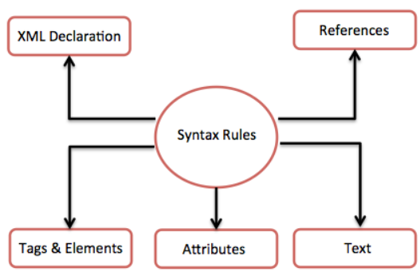
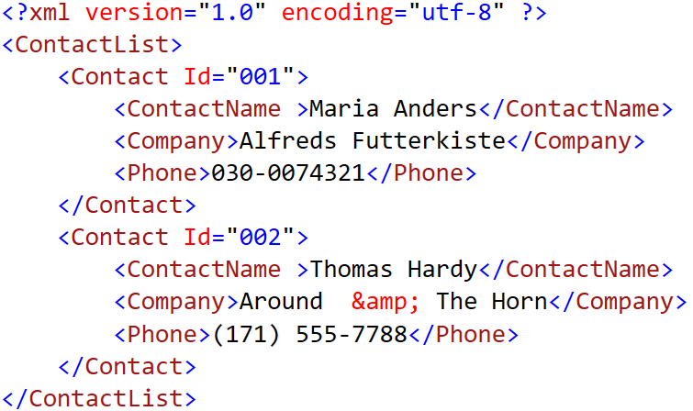
What is the XML?
An XML document can have only one root element. The following diagram depicts the syntax rules to write different types of markup and text in an XML document

Slide 12
XmlDataProvider in WPF Application Demonstration

Slide 13
1.Create a WPF app named ContactListApp
2.Right-click on the project | Add | New Item, select XML File then rename to Contacts.xml , click Add and write contents as follows:
<?xml version="1.0" encoding="utf-8" ?>
<ContactList>
<Contact Id="001">
<ContactName >Maria Anders</ContactName>
<Company>Alfreds Futterkiste</Company>
<Phone>030-0074321</Phone>
</Contact>
<Contact Id="002">
<ContactName >Thomas Hardy</ContactName>
<Company>Around &amp; The Horn</Company>
<Phone>(171) 555-7788</Phone>
</Contact>
<Contact Id="003">
<ContactName >Elizabeth Lincoln</ContactName>
<Company>Bottom-Dollar &amp; Markets</Company>
<Phone>(604) 555-4729</Phone>
</Contact>
</ContactList>

Slide 14
3.Right-click on the project, select Edit Project File and write config information as follows then press Crtl+S to save:
<Project Sdk="Microsoft.NET.Sdk">
<PropertyGroup>
<OutputType>WinExe</OutputType>
<TargetFramework>net5.0-windows</TargetFramework>
<UseWPF>true</UseWPF>
</PropertyGroup>
<ItemGroup>
<Content Include="Contacts.xml"> <CopyToOutputDirectory>PreserveNewest</CopyToOutputDirectory>
</Content>
</ItemGroup>
</Project>

Slide 15
4.Write code for MainWindow.xaml as follows:
<Window x:Class="ContactListApp.MainWindow"
//xmlns:……
Title="Contact List" Height="300" SizeToContent="Width" WindowStartupLocation="CenterScreen">
<Window.Resources>
<XmlDataProvider Source="Contacts.xml" XPath="ContactList/Contact" x:Key="ContactList"/>
</Window.Resources>
<Grid>
<ListView Name="lvContacts" Margin="31,14,31,16"
ItemsSource="{Binding Source={StaticResource ContactList}}">
<ListView.View>
<GridView>
<GridViewColumn Header="Id" DisplayMemberBinding="{Binding XPath=@Id}"/>
<GridViewColumn Header="Contact Name" Width="100"
DisplayMemberBinding="{Binding XPath=ContactName }"/>
<GridViewColumn Header="Company" Width="200"
DisplayMemberBinding="{Binding XPath=Company}"/>
<GridViewColumn Header="Phone" Width="150"
DisplayMemberBinding="{Binding XPath=Phone}"/>
</GridView>
</ListView.View>
</ListView>
</Grid>
</Window>

Slide 16
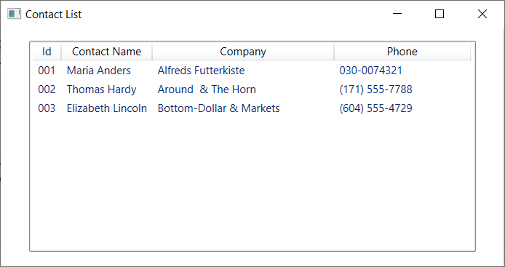
5.Press Crtl+F5 to run project

Slide 17
Understanding XmlSerializer
The XML serialization engine can produce only XML, and it is less powerful than
the binary and data contract serializers in saving and restoring a complex object
The XML serialization is the process of converting an object's public properties and fields to a serial format (in this case, XML) for storage or transport. Deserialization re-creates the object in its original state from the XML output
The data in our objects is described using programming language constructs like classes, fields, properties, primitive types, arrays, and even embedded XML in the form of XmlElement or XmlAttribute objects

Slide 18
Understanding XmlSerializer
The following table describes some of the methods of the XmlSerializer class:
Method Name | Description
CreateReader() | Returns an object used to read the XML document to be serialized
CreateWriter() | When overridden in a derived class, returns a writer used to serialize the object
Deserialize(Stream) | Deserializes the XML document contained by the specified Stream
Deserialize(TextReader) | Deserializes the XML document contained by the specified TextReader
Serialize(Stream, Object) | Serializes the specified Object and writes the XML document to a file using the specified Stream
Serialize(TextWriter, Object) | Serializes the specified Object and writes the XML document to a file using the specified TextWriter

Slide 19
Serializing as XML Demonstration

Slide 20
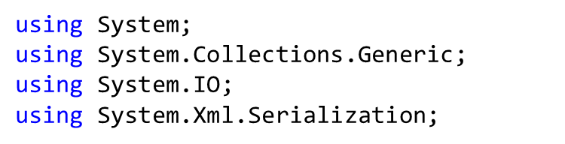
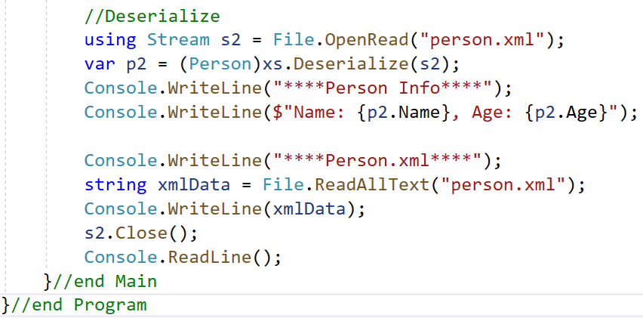
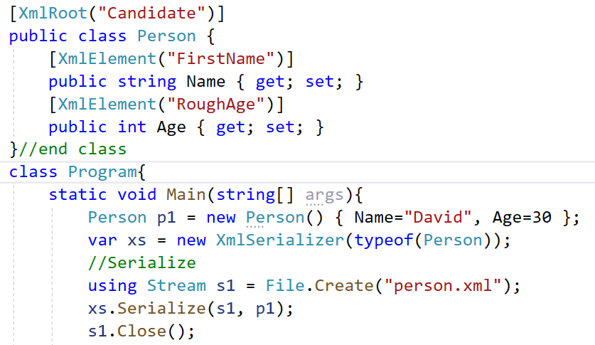
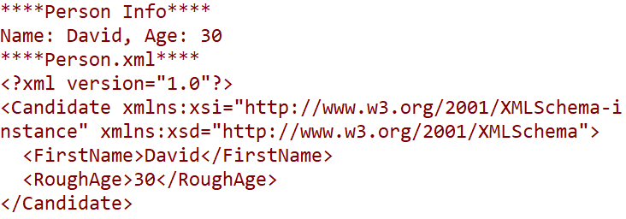
XmlSerializer Demo-01
1. Create a Console app named DemoXmlSerializer
2. Write code for Program.cs as follows then press Ctrl+F5 to run project

Slide 21
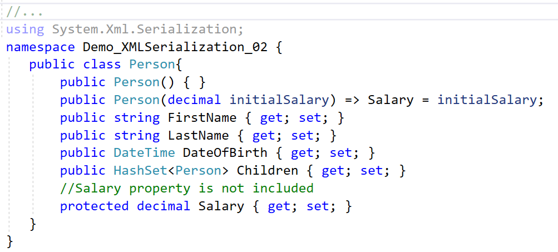
XmlSerializer Demo-02
1. Create a Console app named DemoXmlSerializer02
2. Right-click on the project , select Add | Class named Person.cs then write codes as
follows:
3. Write code for Program.cs as follows then press Ctrl+F5 to run project

Slide 22
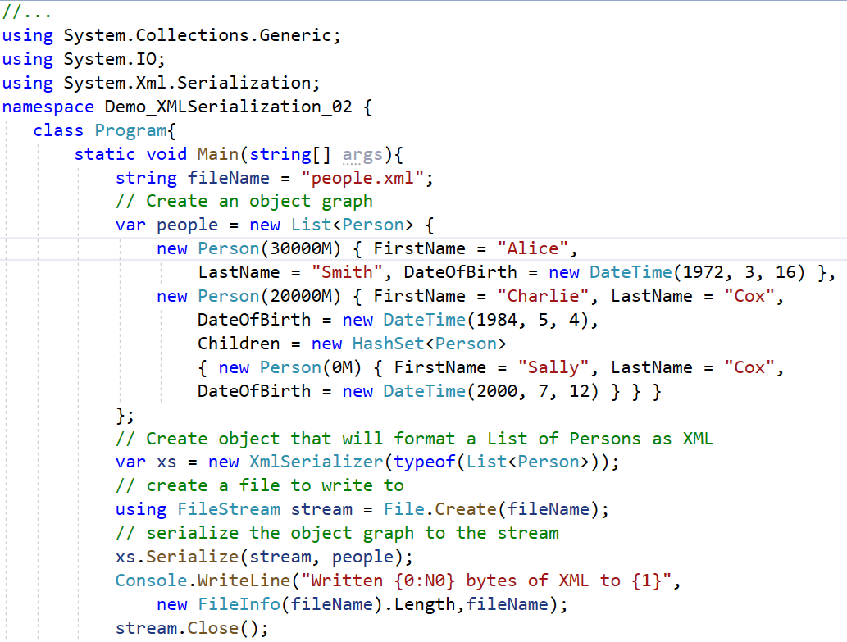

Slide 23
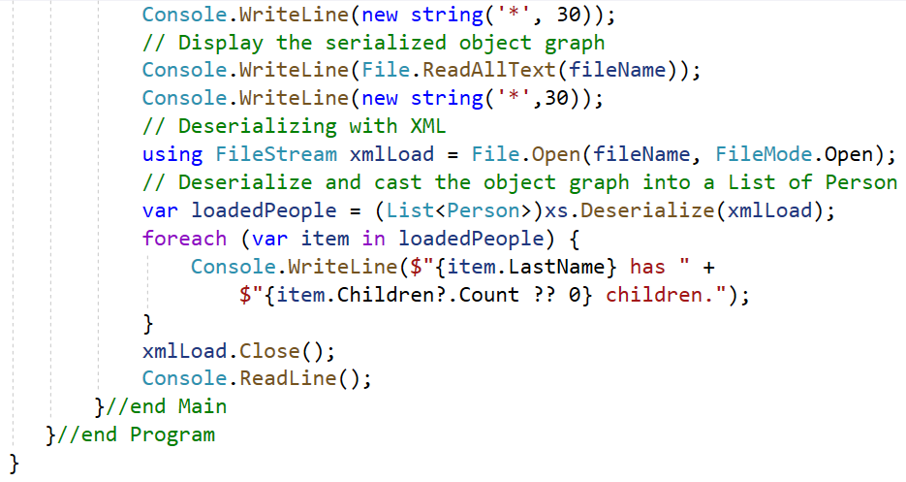
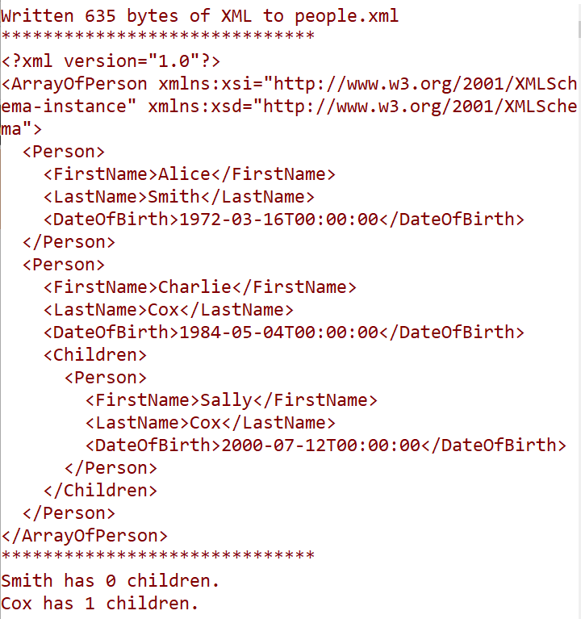

Slide 24
Overview JSON Serialization

Slide 25
What is the JSON?
JSON stands for JavaScript Object Notation
JSON is a lightweight format for storing and transporting data
JSON is often used when data is sent from a server to a web page
JSON is "self-describing" and easy to understand
JSON data is written as name/value pairs, just like JavaScript object properties. A name/value pair consists of a field name (in double quotes), followed by a colon, followed by a value:
{
"firstName":"John", "lastName":"Doe"
}

Slide 26
JSON Syntax Rules
Data is in name/value pairs
Data is separated by commas
Curly braces hold objects
Square brackets hold arrays
{ "employees":
[ {"firstName":"John", "lastName":"Doe"}, {"firstName":"Anna", "lastName":"Smith"}, {"firstName":"Peter", "lastName":"Jones"} ] }

Slide 27
JSON Data Types
JSON supports mainly 06 data types: String, Number, Boolean, null, Object, and Array
String: JSON strings must be written in double quotes like C-language there are various special characters(Escape Characters) in JSON that you can use in strings such as \ (backslash), / (forward slash), b (backspace), n (new line), r (carriage return), t (horizontal tab), etc
Example:
{ "name":"Vivek" }
{ "city":"Delhi\/India" }
here \ / is used for Escape Character / (forward slash)

Slide 28
JSON Data Types
Number: Represented in base 10. The octal and hexadecimal formats are not used
Example: { "age": 20 } , { "percentage": 82.44}
Boolean: This data type can be either true or false
Example: { "result" : true }
Null: It is just a define null value
Example: { "middlename":null }

Slide 29
JSON Data Types
Object: It is a set of name or value pairs inserted between {} (curly braces). The keys must be strings and should be unique and multiple key and value pairs are separated by a, (comma)
Syntax:
{ key : value, .......}
Example:
{
“student":{ "name":“David", "age":20, "score": 50.05}
}

Slide 30
JSON Data Types
Array: It is an ordered collection of values and begins with [ (left bracket) and ends with ] (right bracket). The values of array are separated by ,(comma) Syntax:
[ value, .......]
Example:
{
"collection" : [
{"id" : 101},
{"id" : 102},
{"id" : 103}
]
}

Slide 31
Understanding JSON Serialization
The JSON (JavaScript Object Notation) serializer is fast and efficient, and was introduced relatively recently to .NET (.NET Core). It also offers good version tolerance and allows the use of custom converters for flexibility
JsonSerializer is used by ASP.NET Core 3, removing the dependency on Json.NET, though it is straightforward to opt back in to Json.NET should its features be required
JsonSerializer (in the System.Text.Json namespace) is straightforward to use because of the simplicity of the JSON format. The root of a JSON document is either an array or an object. Under that root are properties, which can be an object, array, string, number, "true", "false", or "null"
The JSON serializer directly maps class property names to property names in JSON

Slide 32
Understanding JSON Serialization
The following table describes some of the methods of the JsonSerializer class:
Method Name | Description
Deserialize(String, Type, JsonSerializerOptions) | Parses the text representing a single JSON value into an instance of a specified type
Deserialize(Utf8JsonReader, Type, JsonSerializerOptions) | Reads one JSON value (including objects or arrays) from the provided reader and converts it into an instance of a specified type
Deserialize<TValue>(String, JsonSerializerOptions) | Parses the text representing a single JSON value into an instance of the type specified by a generic type parameter.
Serialize(Object, Type, JsonSerializerOptions) | Converts the value of a specified type into a JSON string
Serialize(Utf8JsonWriter, Object, Type, JsonSerializerOptions) | Writes the JSON representation of the specified type to the provided writer
SerializeToUtf8Bytes(Object, Type, JsonSerializerOptions) | Converts a value of the specified type into a JSON string, encoded as UTF-8 bytes
Serialize<TValue>(TValue, JsonSerializerOptions) | Converts the value of a type specified by a generic type parameter into a JSON string

Slide 33
Controlling Serialization with Attributes
We can control the serialization process with attributes defined in the System.Text.Json.Serialization namespace
The following subsections present the most useful attributes:
Attribute Name | Description
JsonIgnoreAttribute | Prevents a property from being serialized or deserialized
JsonPropertyNameAttribute | Specifies the property name that is present in the JSON when serializing and deserializing. This overrides any naming policy specified by JsonNamingPolicy
JsonExtensionDataAttribute | When placed on a property of type IDictionary<TKey,TValue>, any properties that do not have a matching member are added to that dictionary during deserialization and written during serialization
JsonConverterAttribute | Converts an object or value to or from JSON
JsonIncludeAttribute | Indicates that the member should be included for serialization and deserialization
JsonNumberHandlingAttribute | When placed on a type, property, or field, indicates what JsonNumberHandling settings should be used when serializing or deserializing numbers

Slide 34
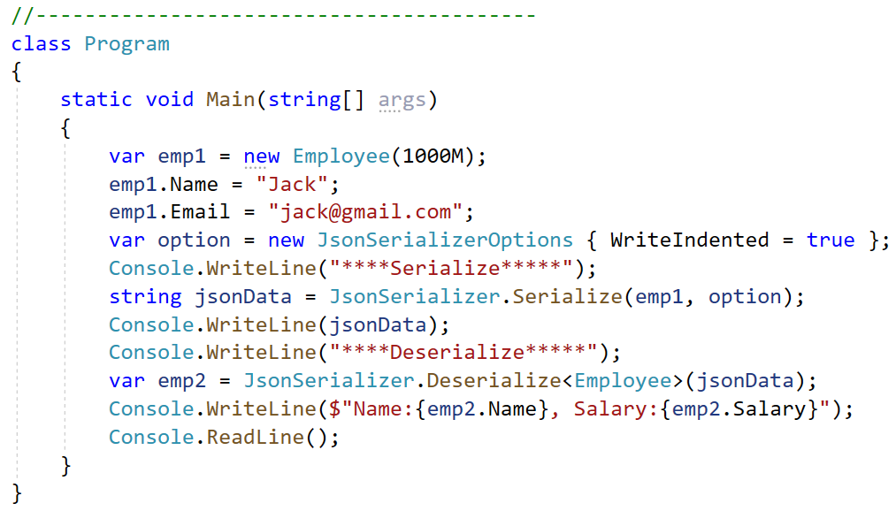
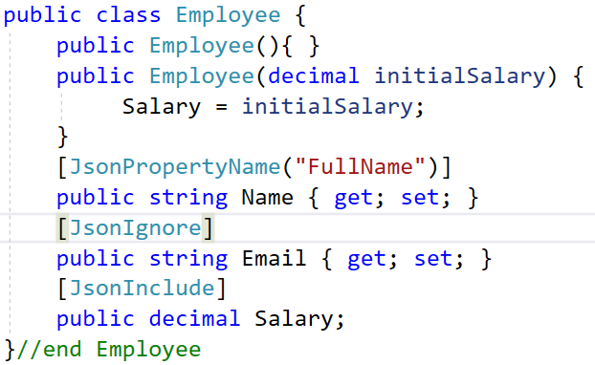
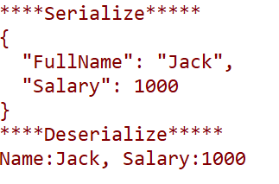
Controlling Serialization with Attributes Demo
//…
using System.Text.Json;
using System.Text.Json.Serialization;

Slide 35
JSON Serialization Options
The serializer accepts an optional JsonSerializationOptions parameter, allowing additional control over the serialization and deserialization process
The following subsections present the most useful options:
Property Name | Description
WriteIndented | Gets or sets a value that defines whether JSON should use pretty printing. By default, JSON is serialized without any extra white space
AllowTrailingCommas | Get or sets a value that indicates whether an extra comma at the end of a list of JSON values in an object or array is allowed (and ignored) within the JSON payload being deserialized
ReadCommentHandling | Gets or sets a value that defines how comments are handled during deserialization
PropertyNameCaseInsensitive | Gets or sets a value that determines whether a property's name uses a case-insensitive comparison during deserialization. The default value is false
ReferenceHandler | Configures how object references are handled when reading and writing JSON

Slide 36
JSON Serialization Options
Property Name | Description
PropertyNamingPolicy | Gets or sets a value that specifies the policy used to convert a property's name on an object to another format, such as camel-casing, or null to leave property names unchanged
DictionaryKeyPolicy | Gets or sets the policy used to convert a IDictionary key's name to another format, such as camel-casing
Encoder | Gets or sets the encoder to use when escaping strings, or null to use the default encoder
IgnoreNullValues | ets or sets a value that determines whether null values are ignored during serialization and deserialization. The default value is false.
IgnoreReadOnlyProperties | Determines whether read-only fields are ignored during serialization. A field is read-only if it is marked with the readonly keyword. The default value is false
MaxDepth | Gets or sets the maximum depth allowed when serializing or deserializing JSON, with the default value of 0 indicating a maximum depth of 64

Slide 37
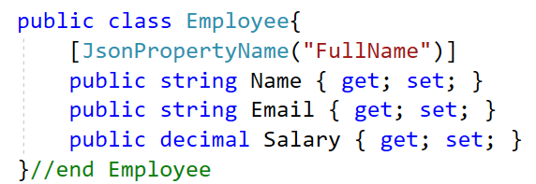
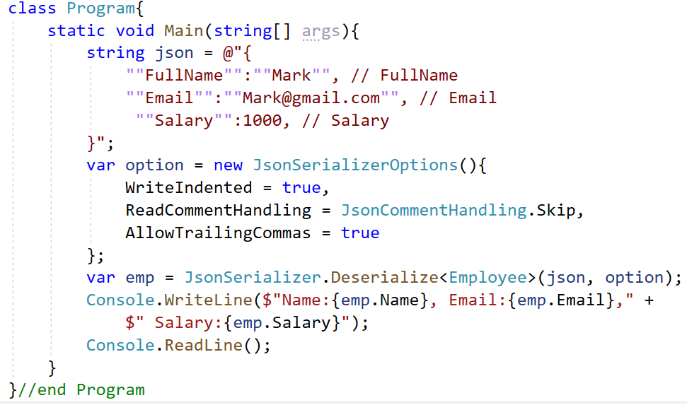

JSON Serialization Options Demo
//…
using System.Text.Json;
using System.Text.Json.Serialization;

Slide 38
Json Serialization Behavior
By default, all public properties are serialized. To ignore individual properties, use the [JsonIgnore] attribute
The default encoder escapes non-ASCII characters, HTML-sensitive characters within the ASCII-range, and characters that must be escaped according to the RFC 8259 JSON spec
By default, JSON is minified. To pretty-print the JSON output, set JsonSerializerOptions.WriteIndented to true
By default, casing of JSON names matches the .NET names. To set the name of individual properties, we can use the [JsonPropertyName] attribute
By default, fields are ignored (use [JsonInclude] attribute to include fields)

Slide 39
Json Deserialization Behavior
By default, property name matching is case-sensitive
If the JSON contains a value for a read-only property, the value is ignored and no exception is thrown. Non-public constructors are ignored by the serializer
Deserialization to immutable objects or read-only properties is supported
By default, enums are supported as numbers. We can serialize enum names as strings
By default, fields are ignored. Use the [JsonInclude] attribute to include fields
The default maximum depth is 64
By default, comments or trailing commas in the JSON throw exceptions. To allow comments in the JSON, we can set the JsonSerializerOptions
.ReadCommentHandling property to JsonCommentHandling.Skip

Slide 40
Serializing as Json Demonstration

Slide 41
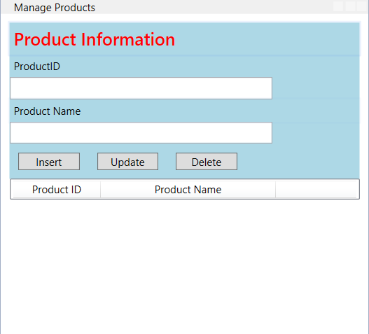
1.Create a WPF app named ManageProductsApp includes a window named WindowManageProducts.xaml that has controls as follows :
Label Control
TextBox Control
Button Control
ListView Control

Slide 42
XAML code of WindowManageProducts.xaml:
<Window x:Class="ManageProductsApp.WindowManageProducts"
xmlns="http://schemas.microsoft.com/winfx/2006/xaml/presentation"
xmlns:x="http://schemas.microsoft.com/winfx/2006/xaml"
xmlns:d="http://schemas.microsoft.com/expression/blend/2008"
xmlns:mc="http://schemas.openxmlformats.org/markup-compatibility/2006"
xmlns:local="clr-namespace:Demo_JSON_Serialization"
mc:Ignorable="d"
Title="Manage Products" Height="430" Width="420"
Loaded="Window_Loaded" WindowStartupLocation="CenterScreen"
ResizeMode="NoResize">
<DockPanel VerticalAlignment="Top" Margin="10">
<Grid>
</Grid>
</DockPanel>
</Window>
View details in next slide

Slide 43
XAML code of Grid tag
<Grid>
<Grid.RowDefinitions>
<RowDefinition Height="*"/>
<RowDefinition Height="*"/>
</Grid.RowDefinitions>
<StackPanel Background="LightBlue" Orientation ="Vertical"
HorizontalAlignment="Left" Width="400">
<Label Name="lblInstruction" Foreground="Red" FontWeight="DemiBold"
FontSize="20" Content="Product Information"/>
<Label Name="lblProductID" Content="ProductID"/>
<TextBox Name="txtProductID" HorizontalAlignment="Left"
Height="25" Width="300"
Text="{Binding Path=ProductID, Mode=OneWay}"
DataContext="{Binding ElementName=lvProducts, Path=SelectedItem}" />
<Label Name="lbProductName" Content="Product Name" />
<TextBox Name="txtProductName" HorizontalAlignment="Left"
Height="25" Width="300" Text="{Binding Path=ProductName, Mode=OneWay}"
DataContext="{Binding ElementName=lvProducts, Path=SelectedItem}" />

Slide 44
XAML code of Grid tag (cont.)
<StackPanel Orientation="Horizontal" HorizontalAlignment="Left">
<Button x:Name="btnInsert" Margin="10" Width="70" Content="Insert"
Click="btnInsert_Click" />
<Button x:Name="btnUpdate" Margin="10" Width="70" Content="Update"
Click="btnUpdate_Click"/>
<Button x:Name="btnDelete" Margin="10" Width="70" Content="Delete"
Click="btnDelete_Click"/>
</StackPanel>
</StackPanel>
<ListView Grid.Row="1" Name="lvProducts" Width="400" >
<ListView.View>
<GridView>
<GridViewColumn Header="Product ID" Width="100"
DisplayMemberBinding="{Binding Path=ProductID }"/>
<GridViewColumn Header="Product Name" Width="200"
DisplayMemberBinding="{Binding Path=ProductName}"/>
</GridView>
</ListView.View>
</ListView>
</Grid>

Slide 45
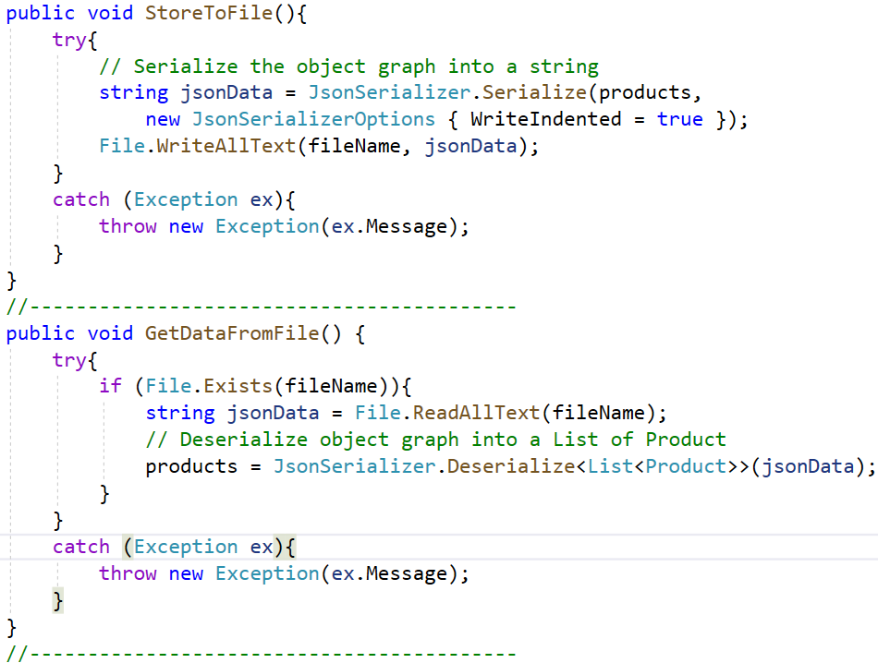

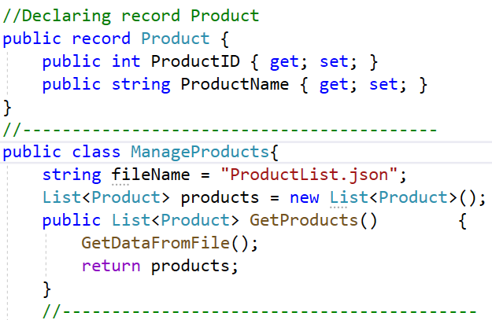
2.Right-click on the project | Add | Class, named ManageProducts.cs then write codes as follows:

Slide 46
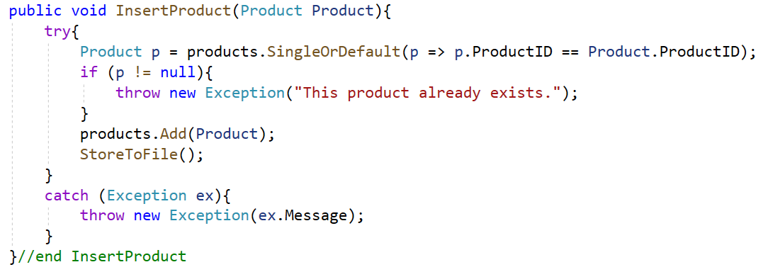
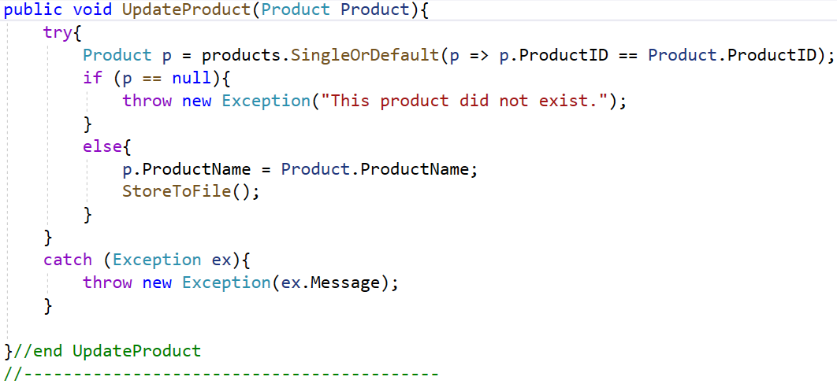

Slide 47
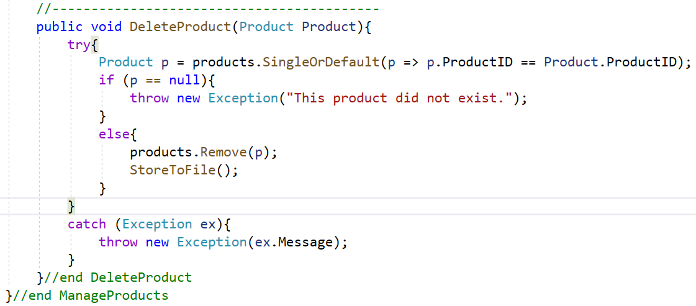
3.Write codes in WindowManageProducts.xaml.cs as follows

Slide 48
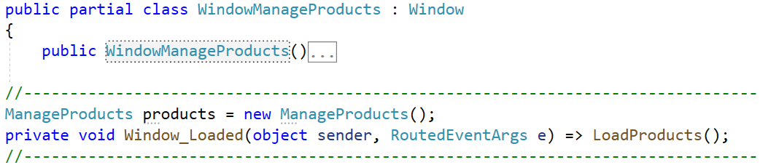
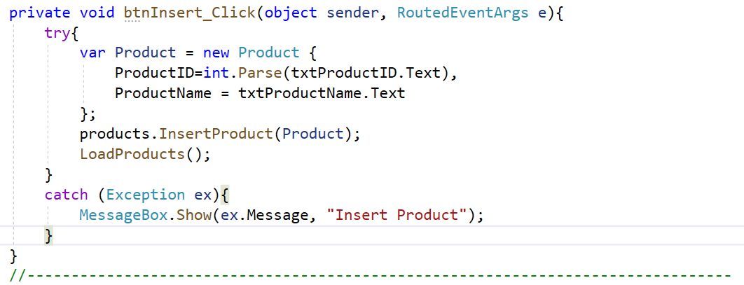

Slide 49
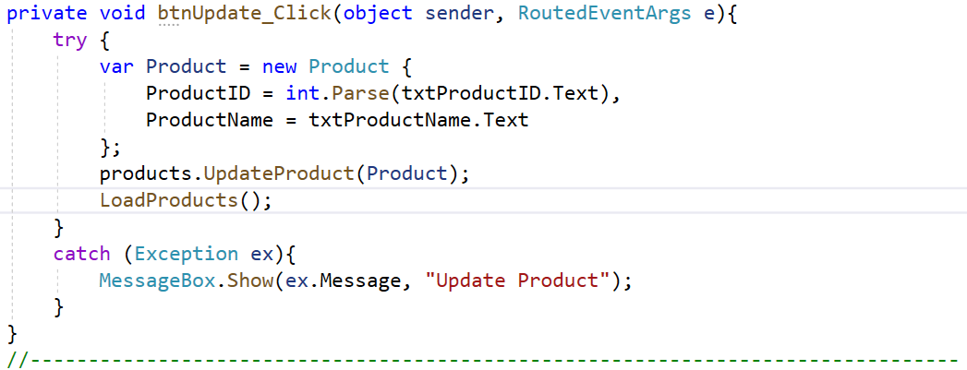
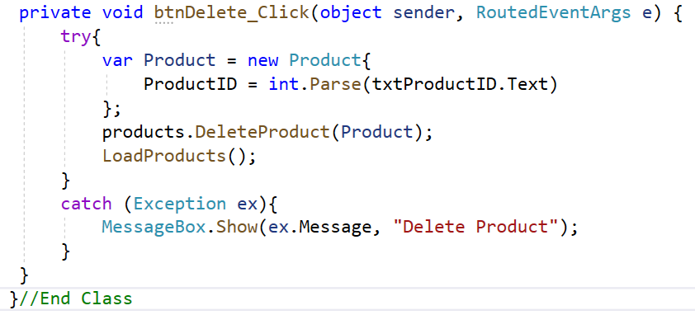

Slide 50
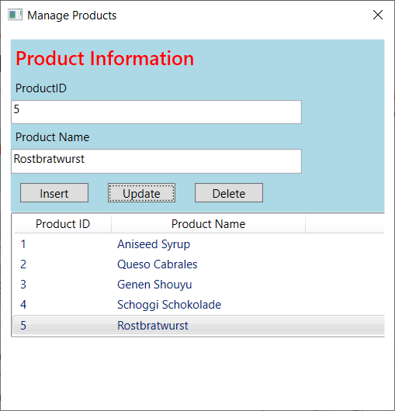
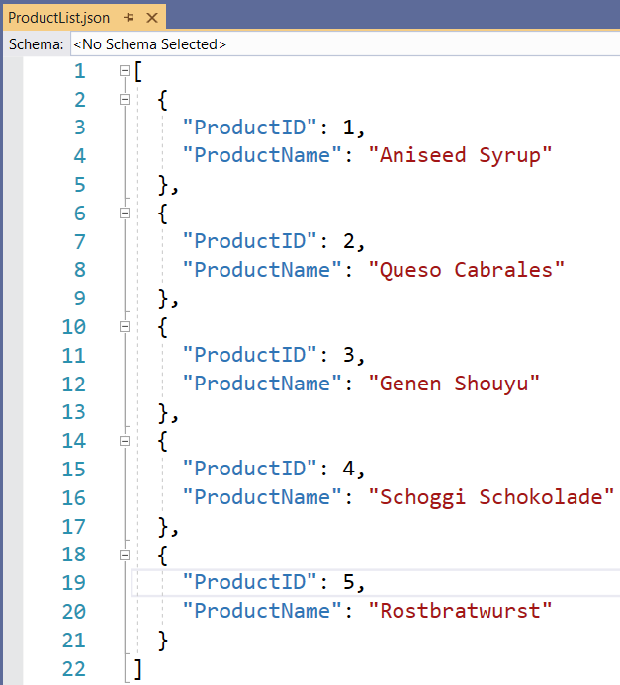
4. Press Ctrl+F5 to run project and view the output

Slide 51
Summary
Concepts were introduced:
Overview Serialization in .NET
Understanding Serialization Engines in .NET
Explain about how serialization works
Describe use Serialization
Overview XML Serialization
Overview JSON Serialization
Create demo using XML with WPF application
Create demo XML Serialization in .NET application
Create demo JSON Serialization in .NET application

